Slide 1
﻿Frequent Directions and its applicatoin in Efficient Anomaly Detection - a practice
謝幸娟 (Hsing-Chuan Hsieh)
connie0915549431@hotmail.com

Slide 2
1. Introduction
Source paper:
Ghashami, M., Liberty, E., Phillips, J. M., & Woodruff, D. P. (2016). Frequent directions: Simple and deterministic matrix sketching. SIAM Journal on Computing, 45(5), 1762-1792.

Slide 3
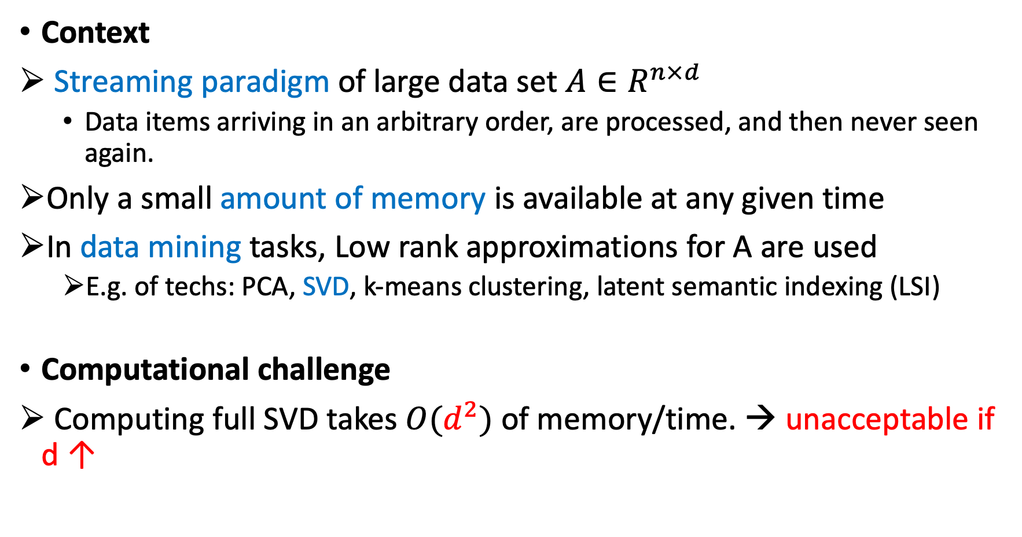
1. Introduction
Context
﻿ ﻿Streaming paradigm of large data set $A∈R^{n×d}$
Data items arriving in an arbitrary order, are processed, and then never seen again.
Only a small amount of memory is available at any given time
﻿In data mining tasks, Low rank approximations for A are used
E.g. of techs: PCA, SVD, k-means clustering, latent semantic indexing (LSI)
Computational challenge
﻿ Computing full SVD takes $O(d^{2})$ of memory/time. → unacceptable if d ↑

Slide 4
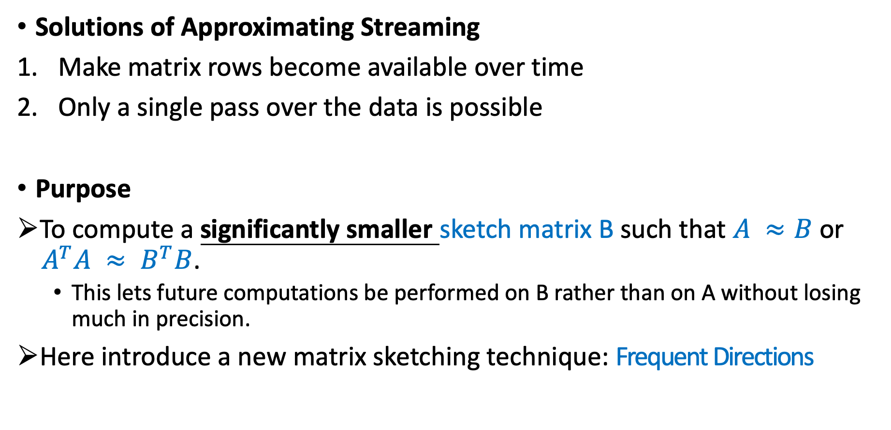
1. Introduction
Solutions of Approximating Streaming
Make ﻿matrix rows become available over time
Only a single pass over the data is possible
Purpose
﻿To compute a significantly smaller sketch matrix B such that $A ≈B$ or $A^{T}A ≈ B^{T}B$.
This lets future computations be performed on B rather than on A without losing much in precision.
Here introduce a new matrix sketching technique: Frequent Directions

Slide 5
2. Frequent Directions
Source paper:
Ghashami, M., Liberty, E., Phillips, J. M., & Woodruff, D. P. (2016). Frequent directions: Simple and deterministic matrix sketching. SIAM Journal on Computing, 45(5), 1762-1792.

Slide 6
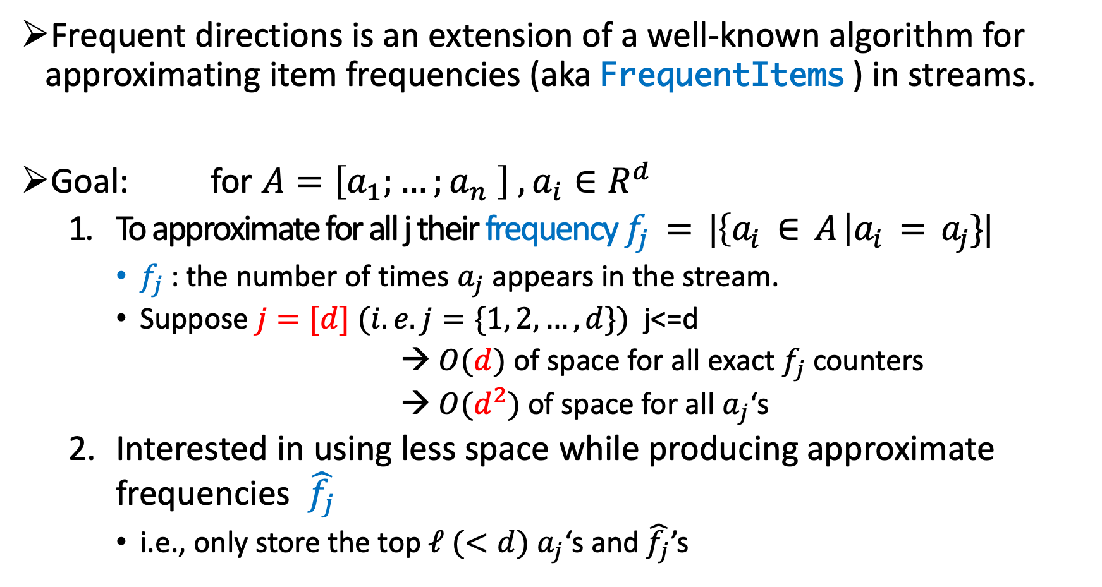
2.1. ﻿Item frequency approximation
Frequent directions is an extension of a well-known algorithm for approximating item frequencies (aka FrequentItems ) in streams.
Goal: ﻿ for $A=\left[a_{1};…;a_{n} \right] , a_{i}∈R^{d}$
To approximate for all j their frequency $f_{j} = |\left\{a_{i} ∈ A \right|a_{i} = a_{j}\}|$
$f_{j}$: the number of times $a_{j}$ appears in the stream.
Suppose $j=[d] (i.e. j=\{1, 2,…, d\})$ j<=d
→ $O(d)$ of space for all exact $f_{j}$counters
→ $O(d^{2})$ of space for all $a_{j}$‘s
Interested in using less space while producing approximate frequencies $\hat{f_{j}}$
i.e., only store the top $ℓ (<d) a_{j}$‘s and $\hat{f_{j}}$’s

Slide 7
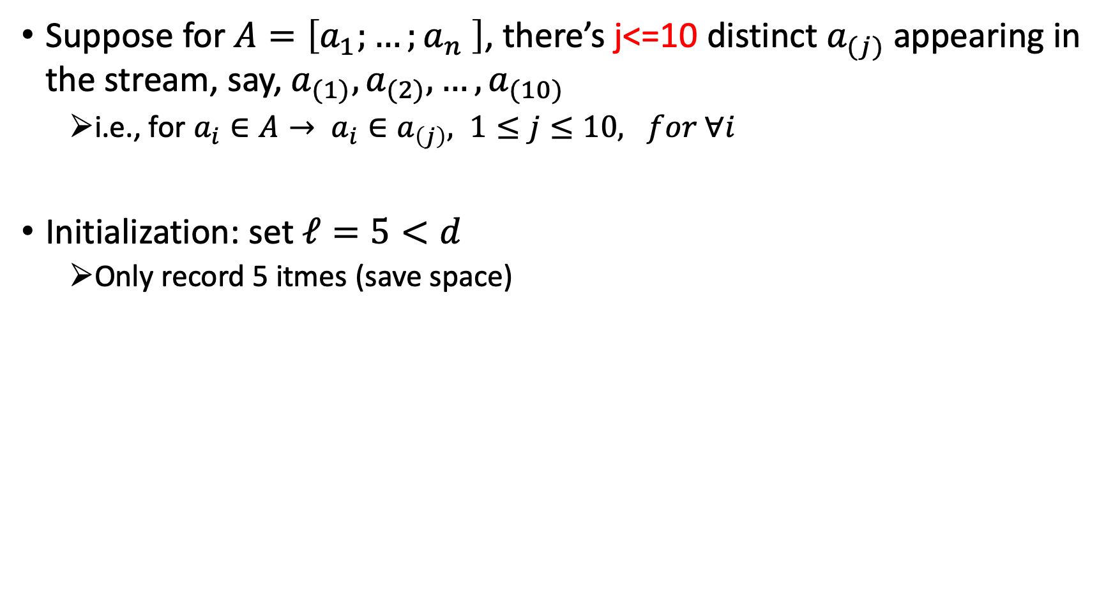
2.2. Algorithm Simulation of FrequentItems
Suppose for $A=\left[a_{1};…;a_{n} \right]$, there’s j<=10 distinct $a_{(j)}$ appearing in the stream, say, $a_{(1)},a_{(2)}, …,a_{(10)}$
i.e., for $a_{i}∈A→ a_{i}∈a_{\left(j\right)}, 1≤j≤10, for ∀i$
Initialization: set $ℓ=5<d$
Only record 5 itmes (save space)
Items | Counters
 | 0
 | 0
 | 0
 | 0
 | 0
$$a_{(1)}$$
$$a_{(2)}$$
At least one of the items is mapped to a counter of value zero.
$$a_{(3)}$$
$$a_{(4)}$$
$$a_{(5)}$$

Slide 8
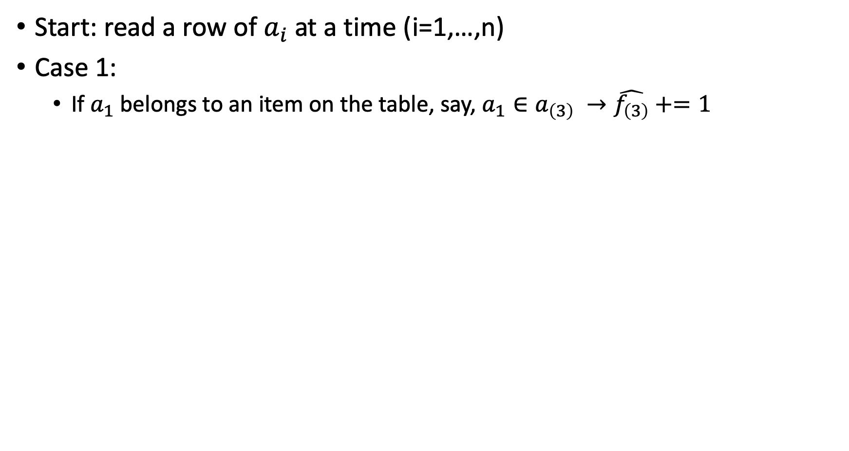
2.2. Algorithm Simulation of FrequentItems
Start: read a row of $a_{i}$at a time (i=1,…,n)
Case 1:
If $a_{1}$ belongs to an item on the table, say, $a_{1}∈a_{\left(3\right)} →\hat{f_{\left(3\right)}}+=1$
$$a_{1}$$
Items | Counters
 | 0
 | 0
 | 1
 | 0
 | 0
Items | Counters
 | 0
 | 0
 | 0
 | 0
 | 0
$$a_{(1)}$$
$$a_{(2)}$$
$$a_{(3)}$$
Counter is incremented
$$a_{(4)}$$
$$a_{(5)}$$

Slide 9
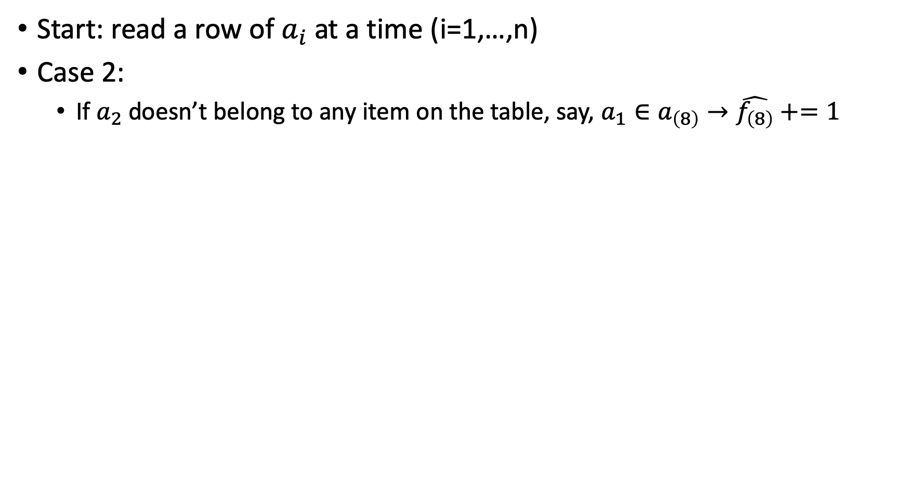
2.2. Algorithm Simulation of FrequentItems
Start: read a row of $a_{i}$at a time (i=1,…,n)
Case 2:
If $a_{2}$ doesn’t belong to any item on the table, say, $a_{1}∈a_{\left(8\right)}→\hat{f_{\left(8\right)}}+=1$
$$a_{2}$$
Items | Counters
 | 0
 | 0
 | 1
 | 0
 | 1
Items | Counters
 | 0
 | 0
 | 1
 | 0
 | 0
$$a_{(1)}$$
$$a_{(2)}$$
it replaces one of the items mapping to zero value with the new item
$$a_{(3)}$$
$$a_{(4)}$$
$$a_{(8)}$$
$$a_{(5)}$$

Slide 10
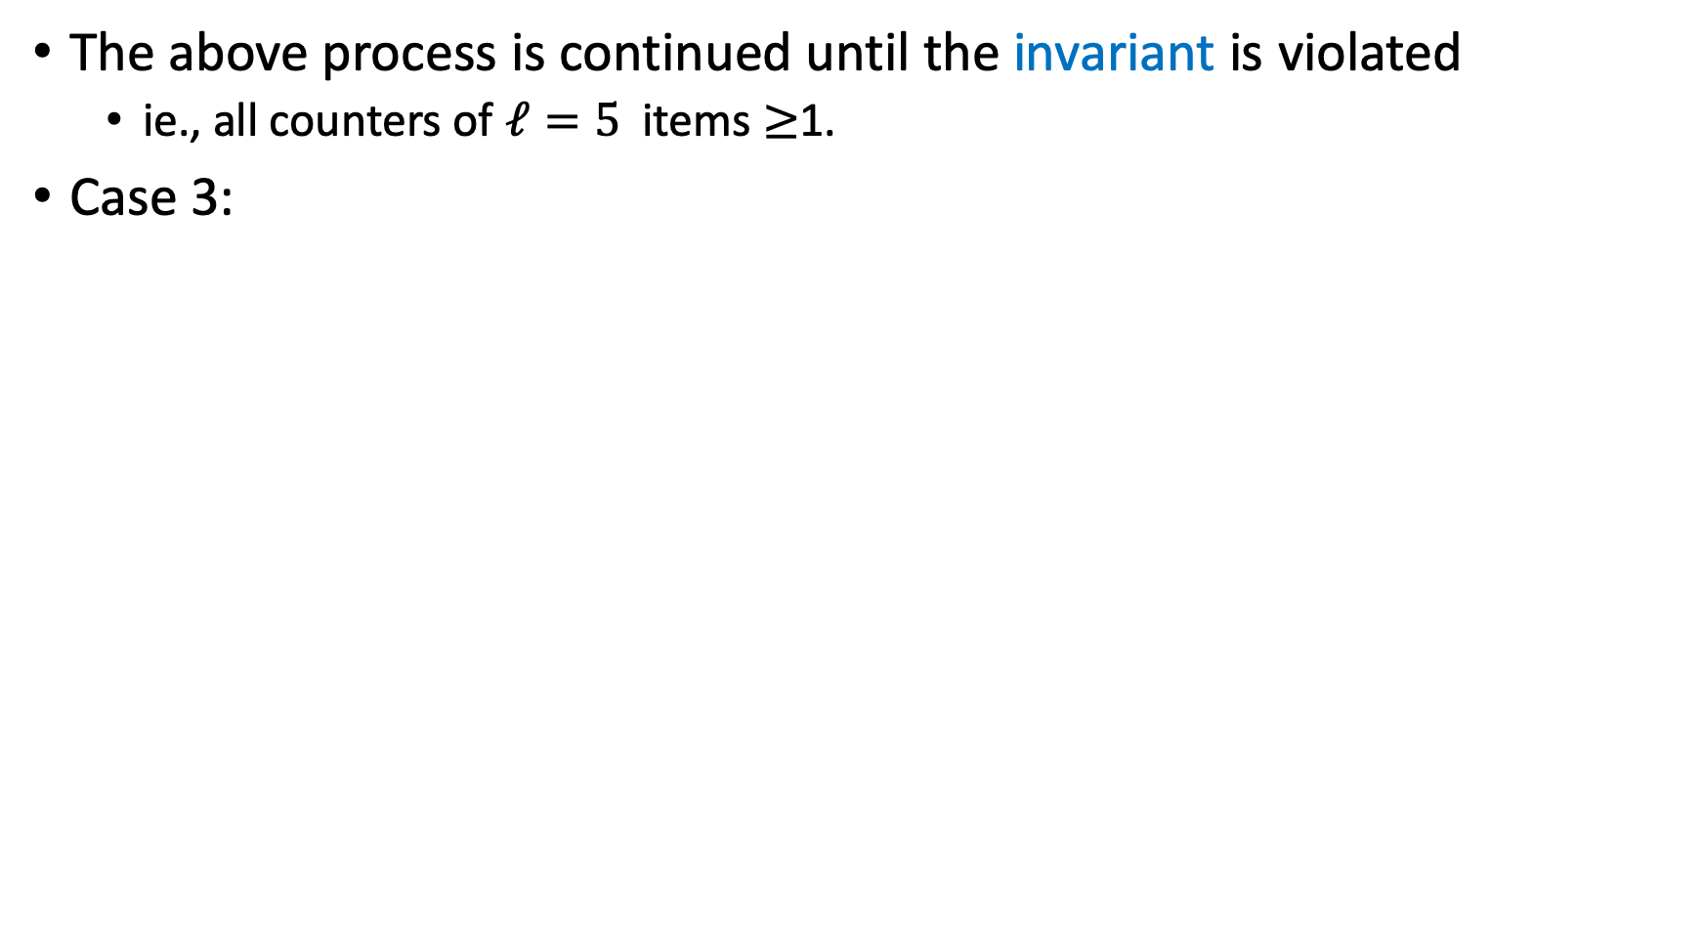
2.2. Algorithm Simulation of FrequentItems
﻿The above process is continued until the invariant is violated
﻿ie., all counters of $ℓ=5$ items $≥$1.
Case 3:
At this point, all counts are decreased by the same amount until at least one item maps to a zero value.
Items | Counters
 | 6
 | 2
 | 3
 | 2
 | 4
Items | Counters
 | 4
 | 0
 | 1
 | 0
 | 2
$$a_{(1)}$$
-2
$$a_{(5)}$$
-2
$$a_{(3)}$$
-2
$$a_{(10)}$$
-2
$$a_{(8)}$$
$$a_{(5)}$$
-2

Slide 11
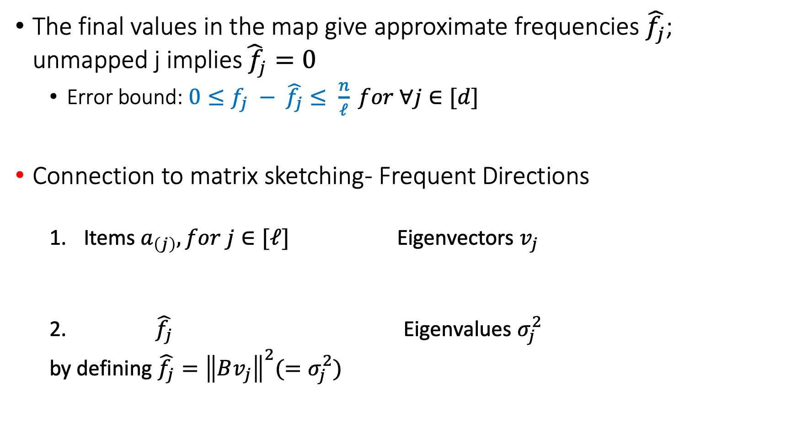
2.2. Algorithm Simulation of FrequentItems
﻿The final values in the map give approximate frequencies $\hat{f_{j}}$; unmapped j implies$\hat{{ f}_{j}}=0$
Error bound: $0≤f_{j} − \hat{f_{j}}≤ \frac{n}{ℓ} for ∀j∈[d]$
﻿Connection to matrix sketching- Frequent Directions
Items $a_{\left(j\right)}, for j∈[ℓ]$ Eigenvectors $v_{j}$
$\hat{f_{j}}$ Eigenvalues $σ_{j}^{2}$
by defining $\hat{f_{j}}={\left\|Bv_{j}\right\|}^{2}(=σ_{j}^{2})$

Slide 12
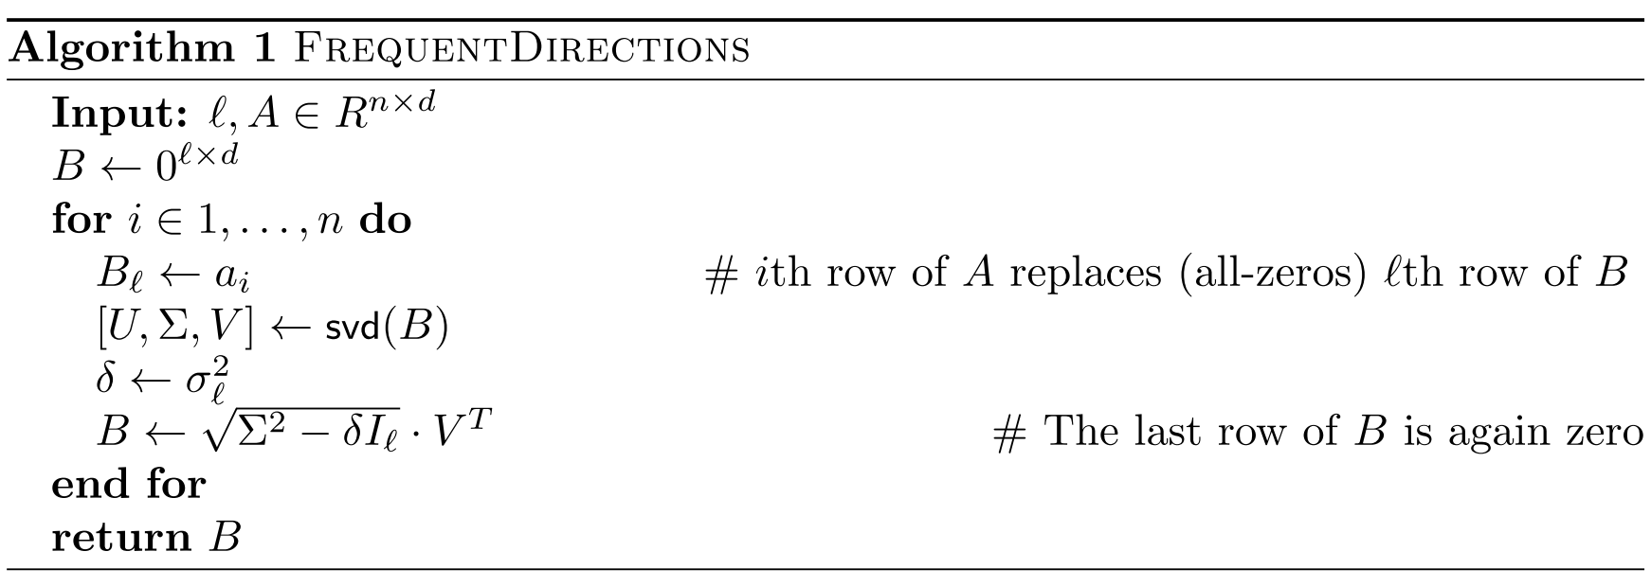
2.3. Algorithm of FrequentDirections
SVD running time ~ $O\left(dℓ^{2}\right)$. (dominate running time of Algorithm 1)
Total running time ~ $O\left(dℓ^{2}\right)$

Slide 13
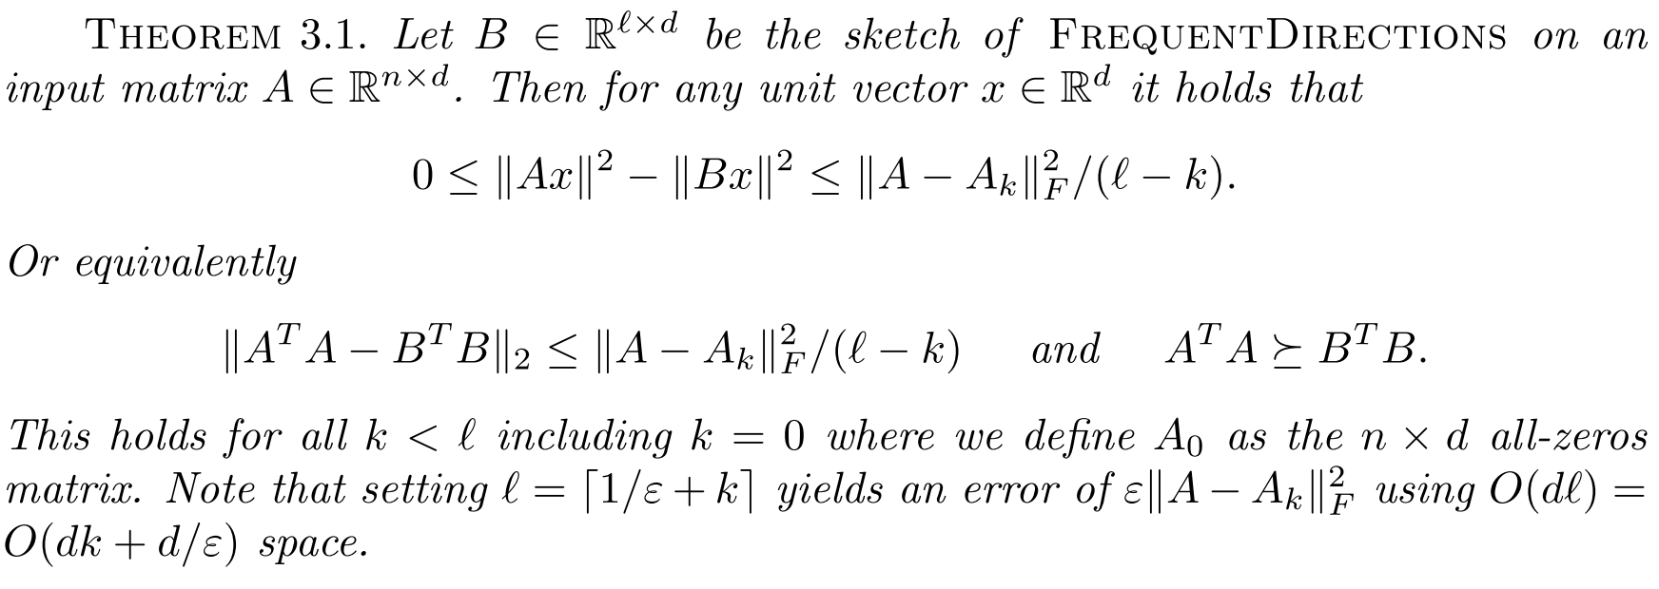
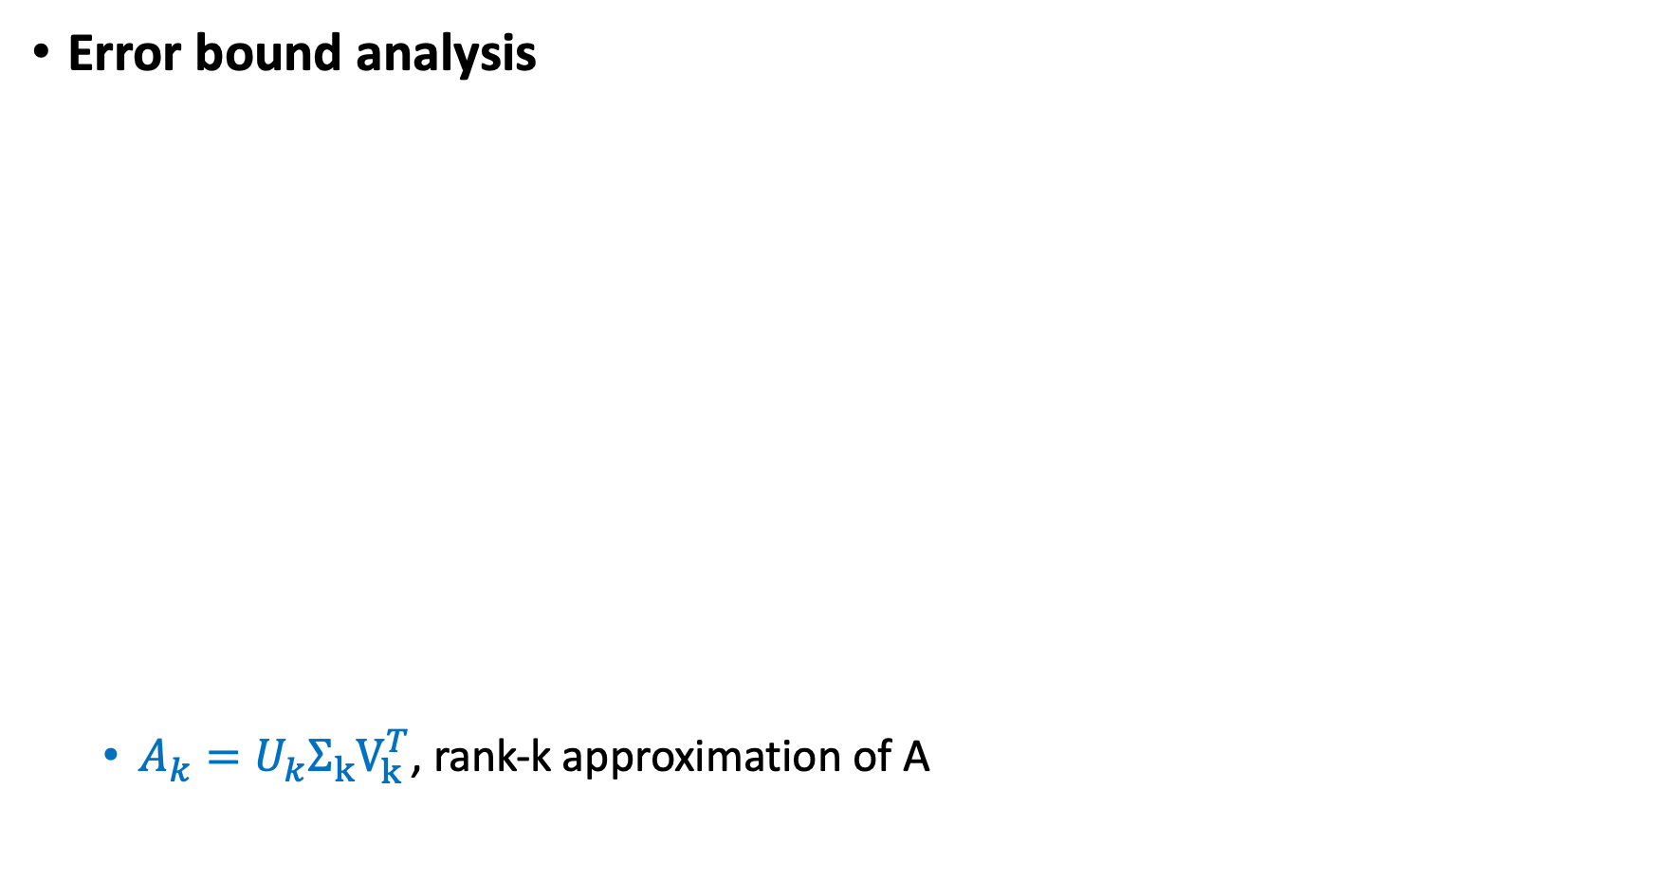
2.3. Algorithm of FrequentDirections
Error bound analysis
$A_{k}=U_{k}Σ_{k}V_{k}^{T}$, rank-k approximation of A﻿

Slide 14
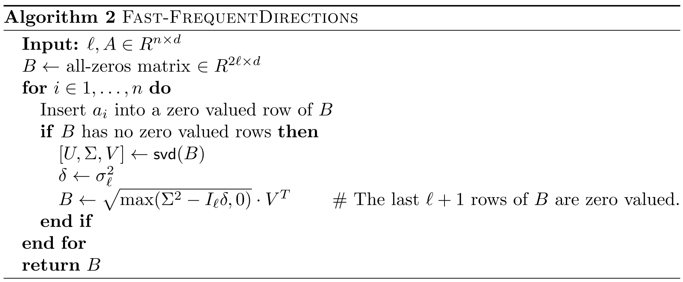
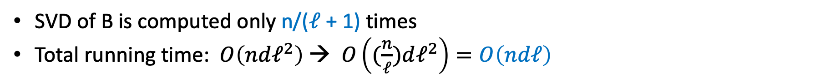
2.3. Algorithm of FrequentDirections
﻿SVD of B is computed only n/($ℓ$ + 1) times
Total running time: $O\left(ndℓ^{2}\right)$ → $O\left((\frac{n}{ℓ})dℓ^{2}\right)=O\left(ndℓ\right)$

Slide 15
3. A Practice
Practice writing algorithm of
Frequent Directions (Algorithm)
Rank-k Leverage scores
Rank-k Projection scores

Slide 16
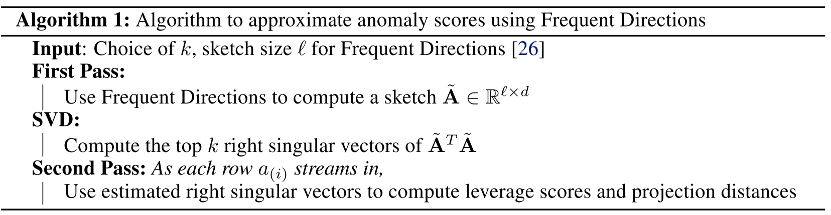
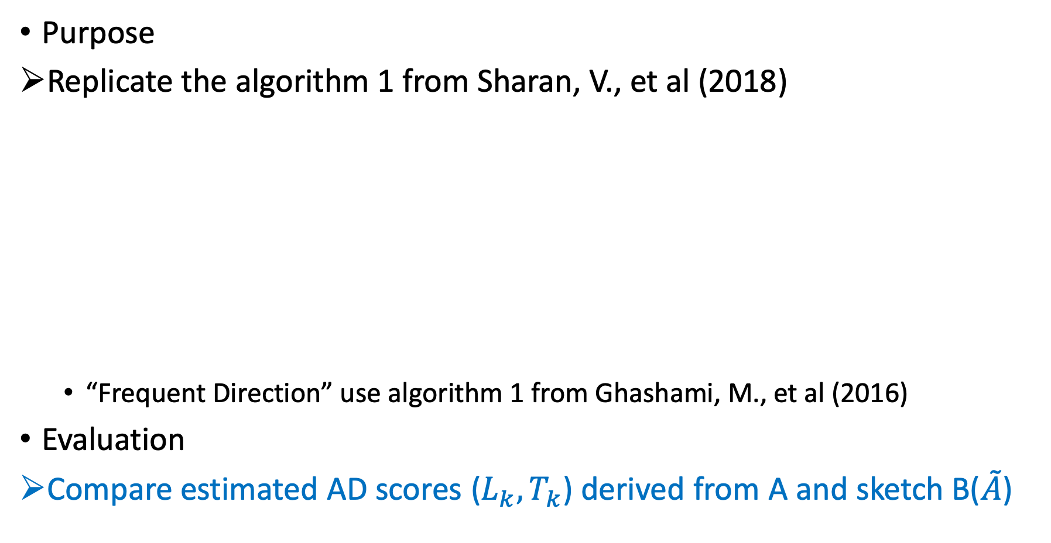

3.1. Introduction
Purpose
Replicate the algorithm 1 from Sharan, V., et al (2018)
“Frequent Direction” use algorithm 1 from Ghashami, M., et al (2016)
Evaluation
Compare estimated AD scores ($L_{k}, T_{k}$) derived from A and sketch B($\tilde{A}$)
or SVD of $\tilde{A}=UVD^{T}$
Notes:
algorithm 1 paper source:
Sharan, V., Gopalan, P., & Wieder, U. (2018). Efficient anomaly detection via matrix sketching. In Advances in Neural Information Processing Systems (pp. 8069-8080).

Slide 17
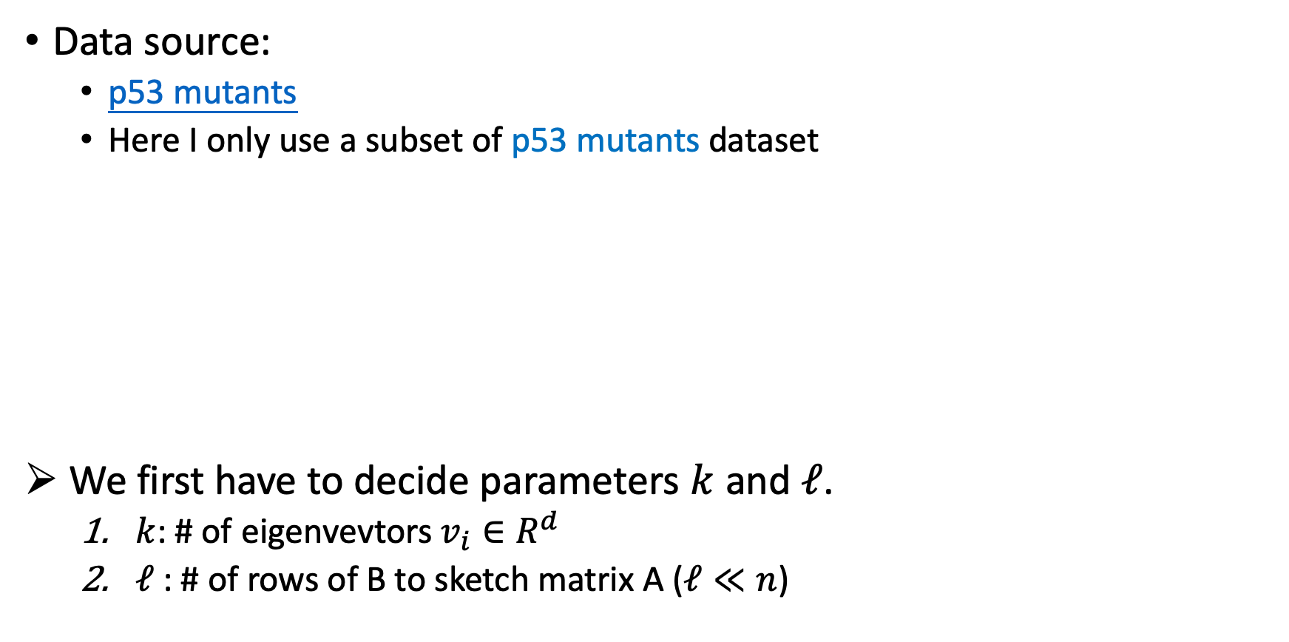
3.2. Data
Data source:
﻿p53 mutants
Here I only use a subset of p53 mutants dataset
We first have to decide parameters $k$ and $ℓ$.
$k$: # of eigenvevtors $v_{i}∈R^{d}$
$ℓ$: # of rows of B to sketch matrix A ($ℓ≪n$)
Data | Size (﻿n × d)
p53 mutants | ﻿16772 × 5408
Subset used: A | 5681 × 5408
Notes:
Data source paper:
﻿Danziger S.A. et al. Functional census of mutation sequence spaces: the example of p53 cancer rescue mutants. IEEE/ACM transactions on computational biology and bioinformatics, 2006.

Slide 18
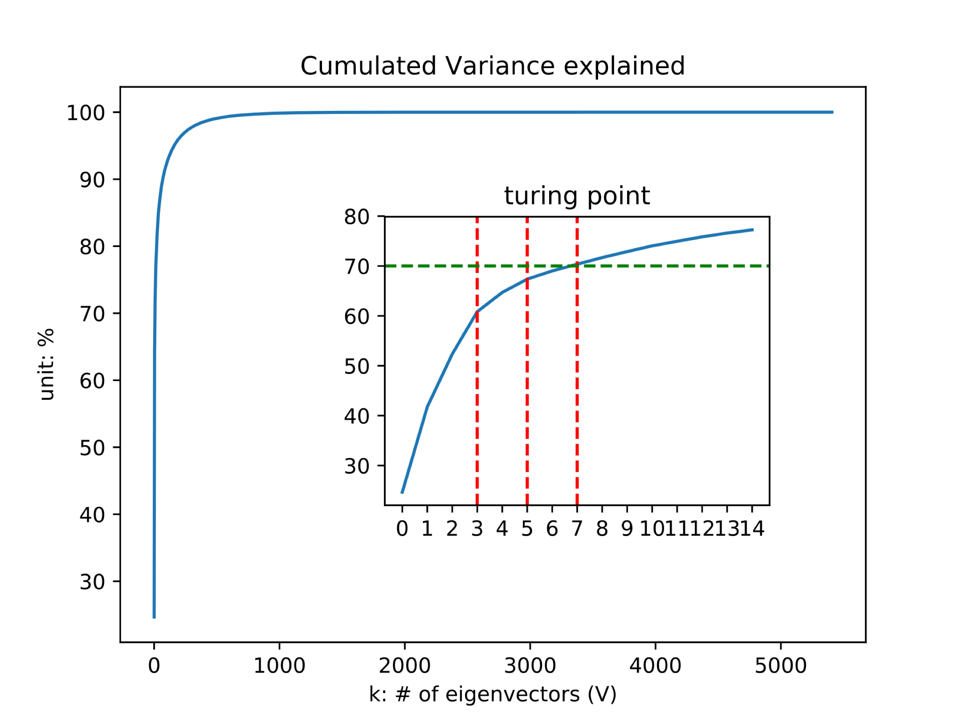
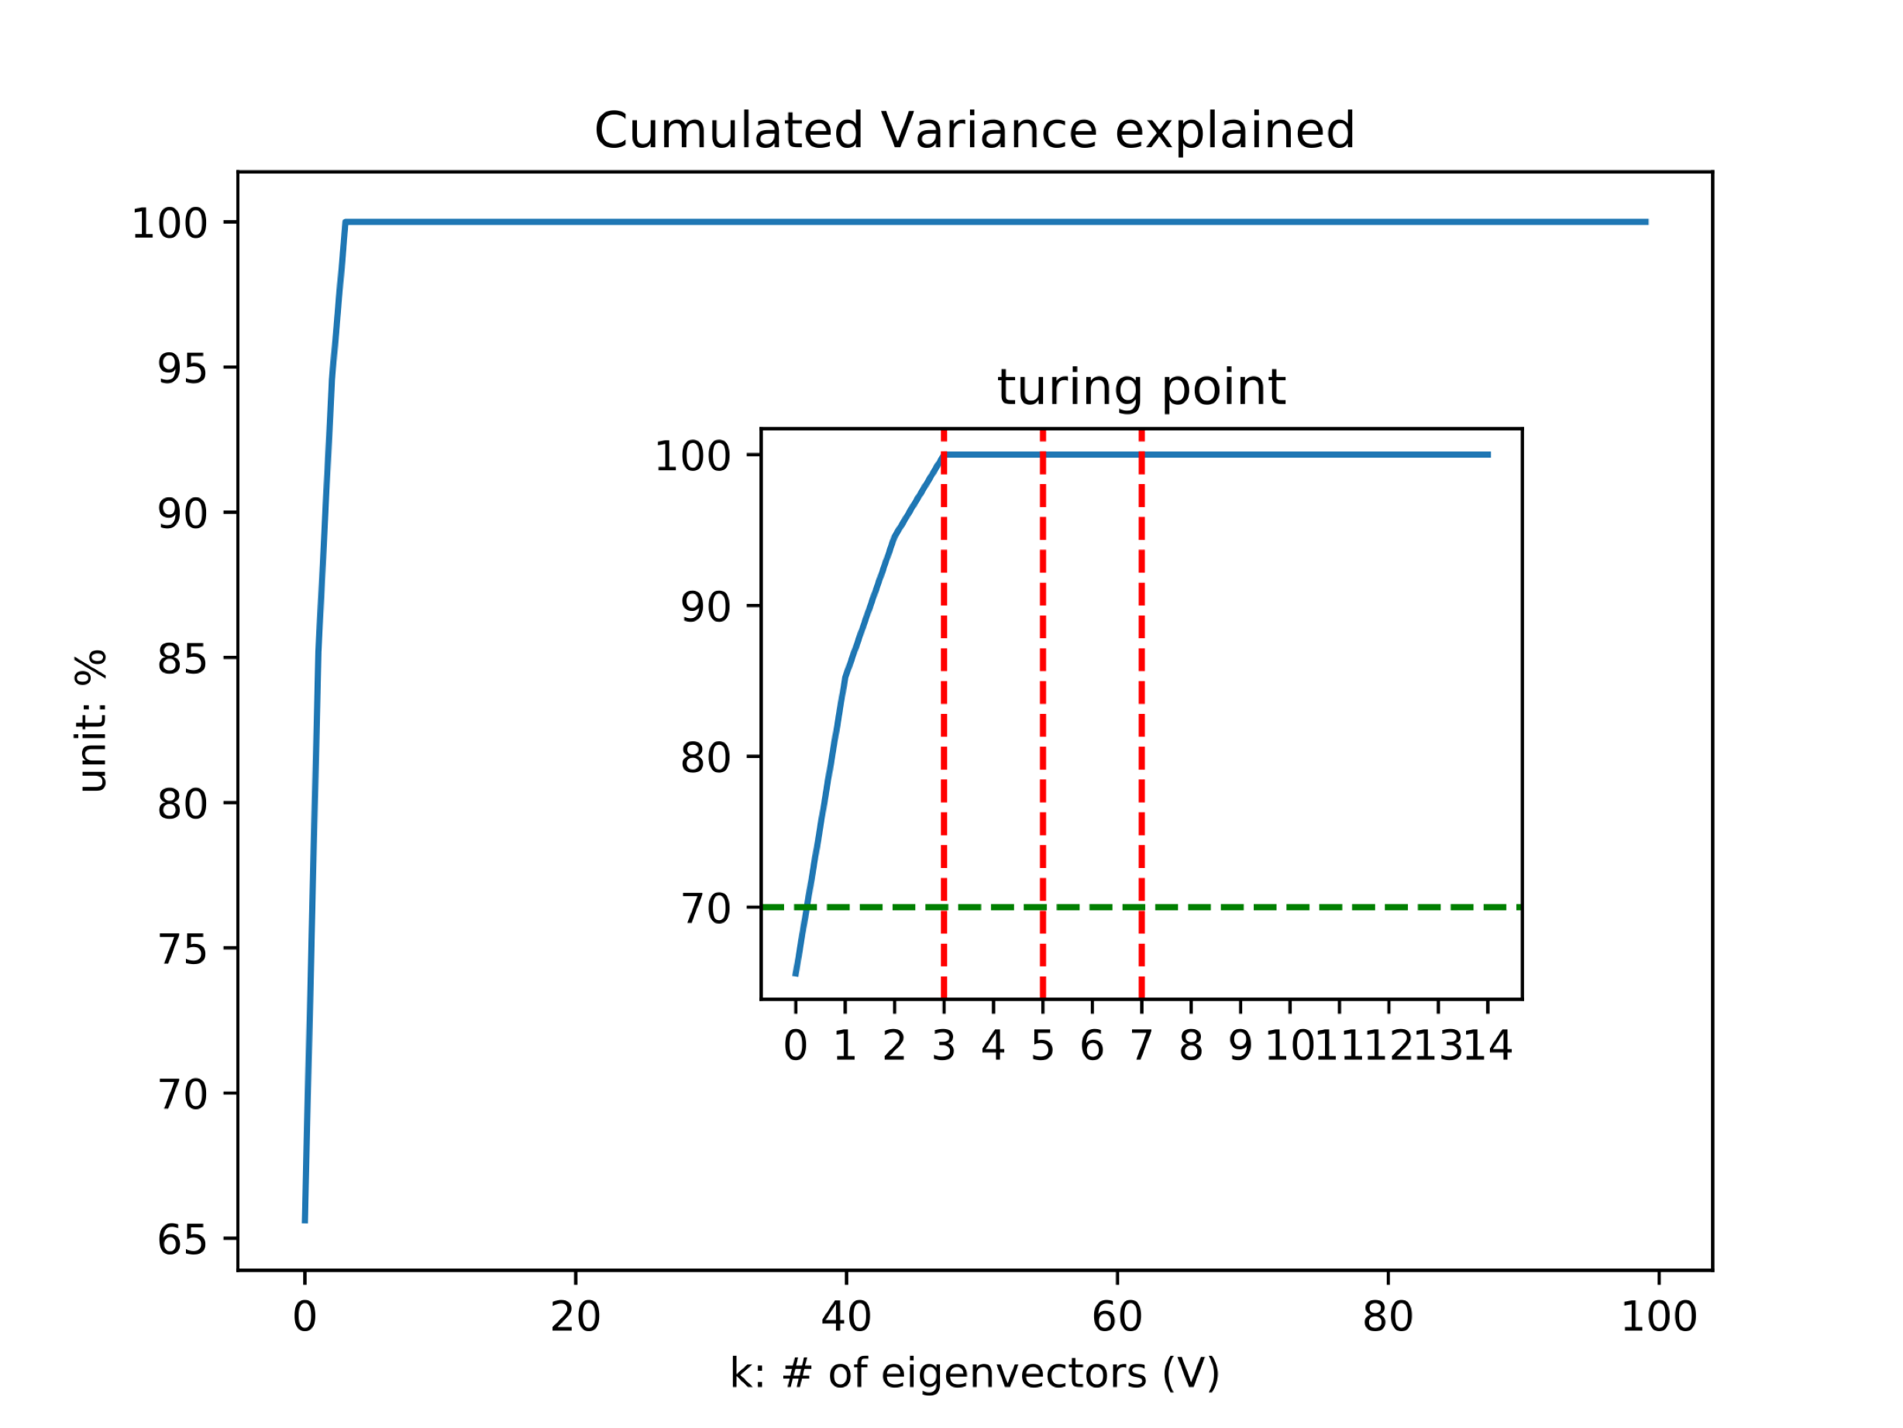


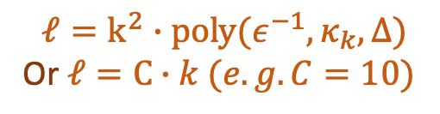
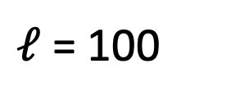
3.2. Data
Data exploration: SVD for deciding k (# of eigenvectors)
Origin: $A∈R^{n×d}$
Sketch: B ($\tilde{A}$) $∈R^{l×d}$
K = 7
$$ℓ=k^{2}∙poly(ε^{−1},κ_{k}, Δ)$$
Or $ℓ=C∙k (e.g. C=10)$
$ℓ$ = 100
Notes:
Data source paper:
﻿Danziger S.A. et al. Functional census of mutation sequence spaces: the example of p53 cancer rescue mutants. IEEE/ACM transactions on computational biology and bioinformatics, 2006.

Slide 19
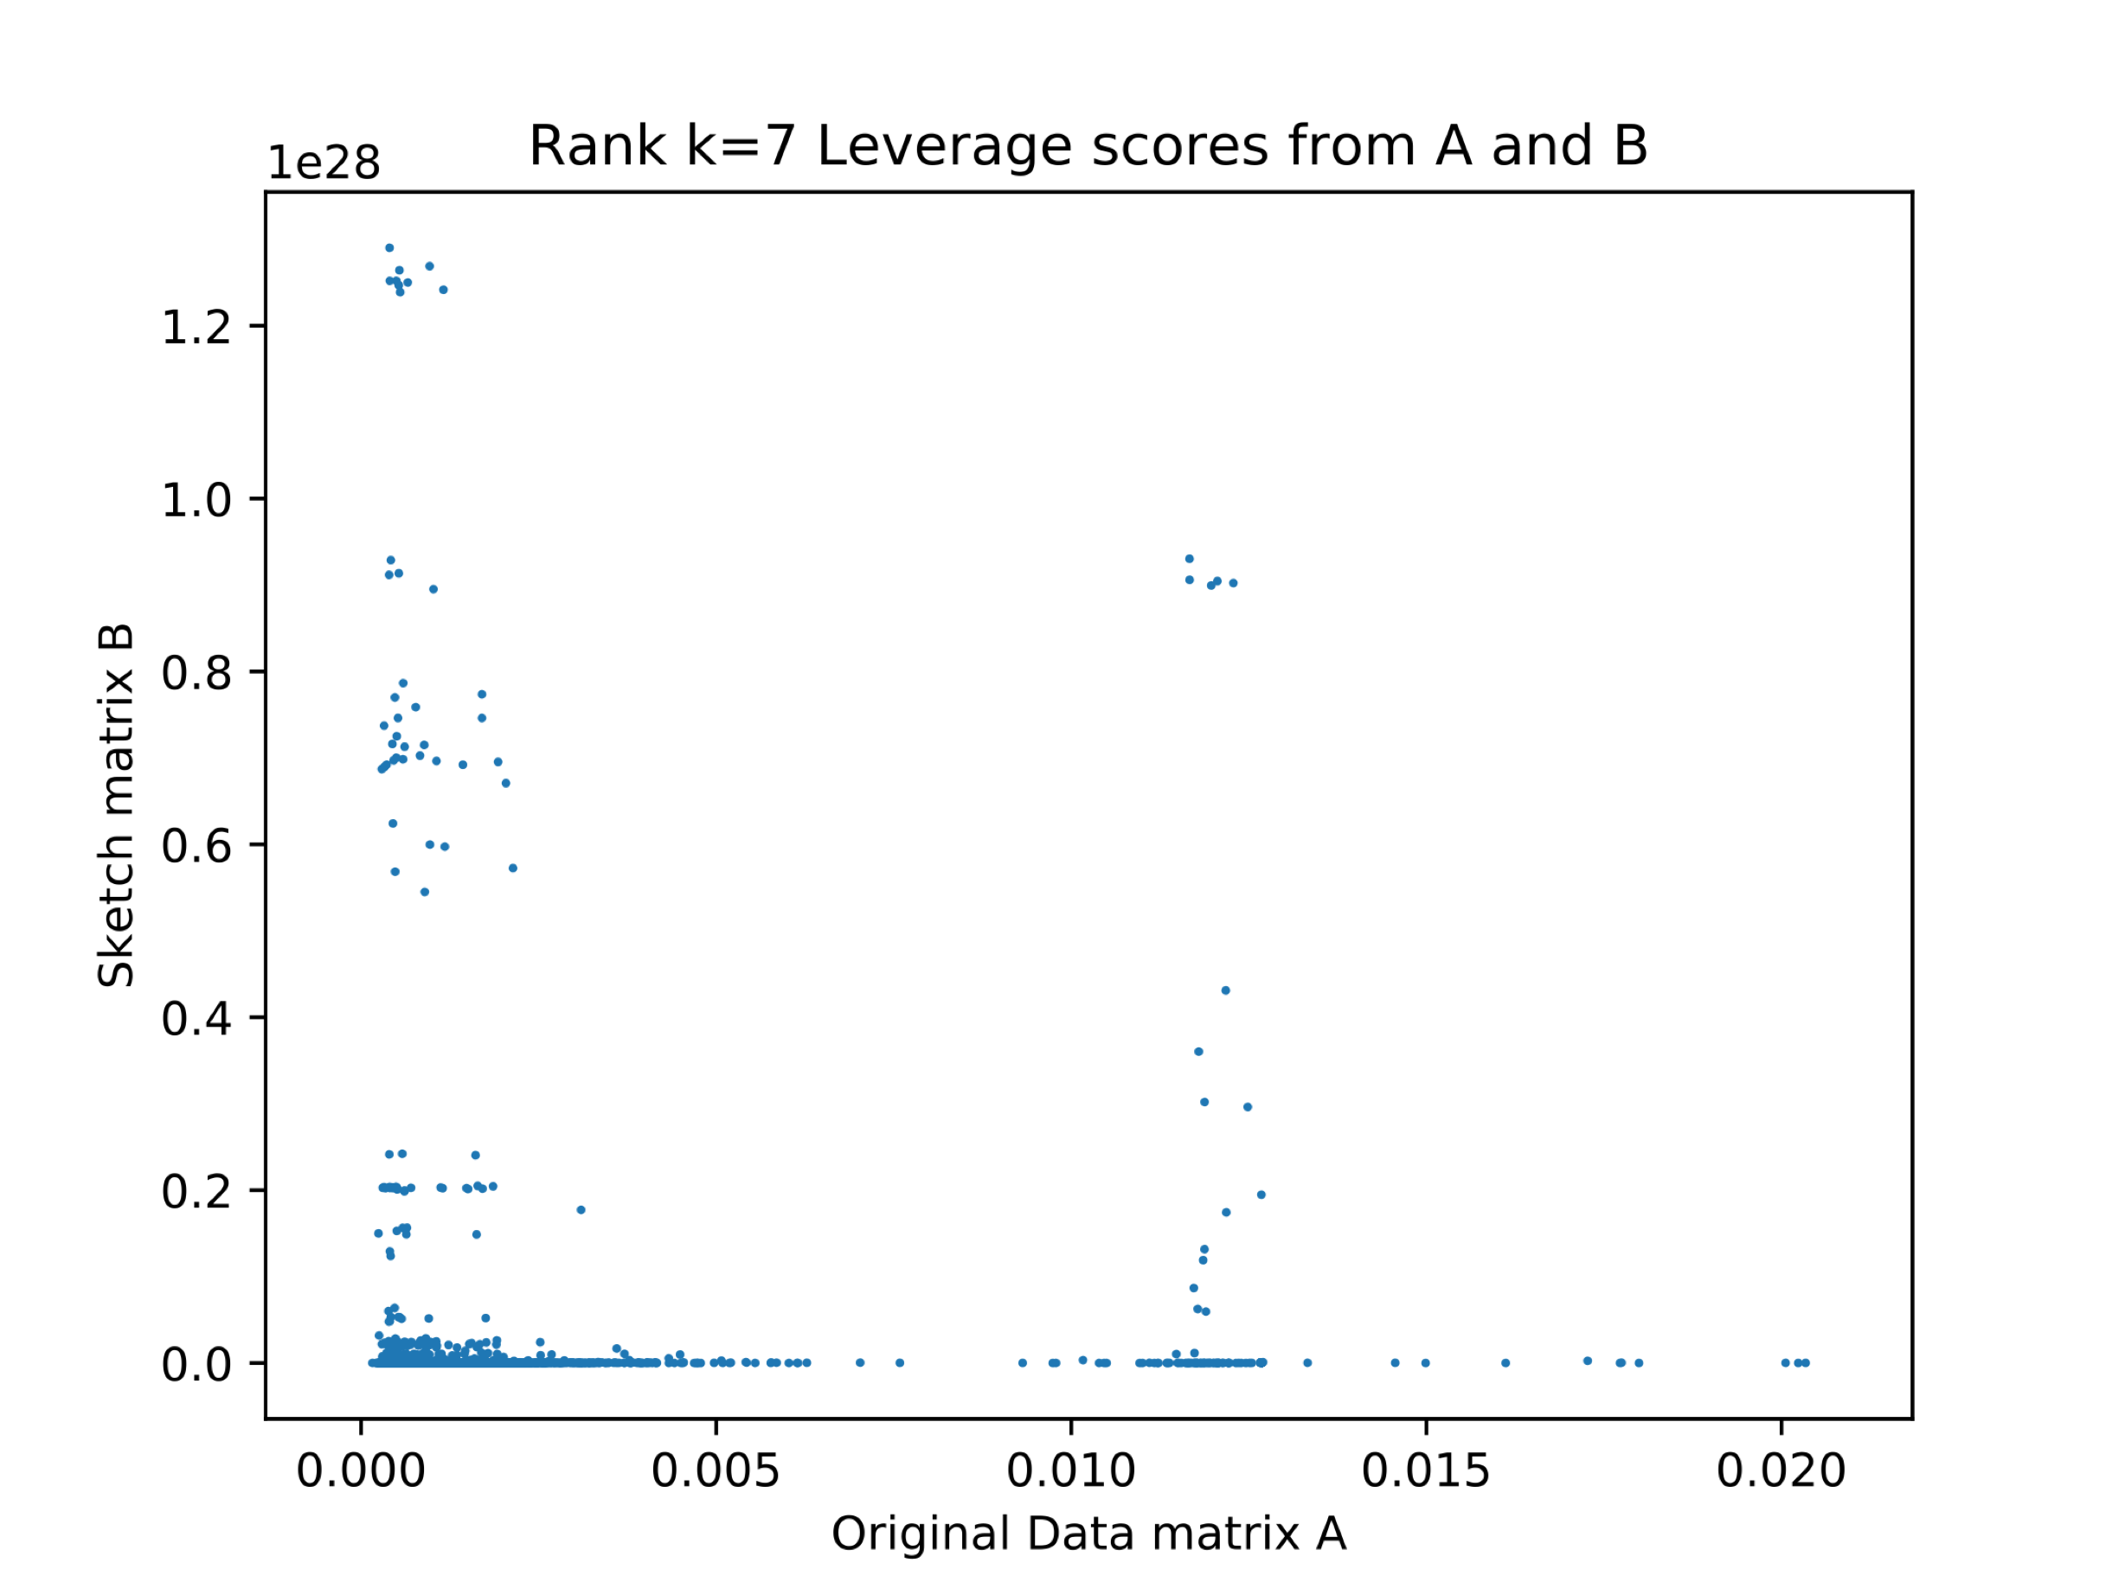
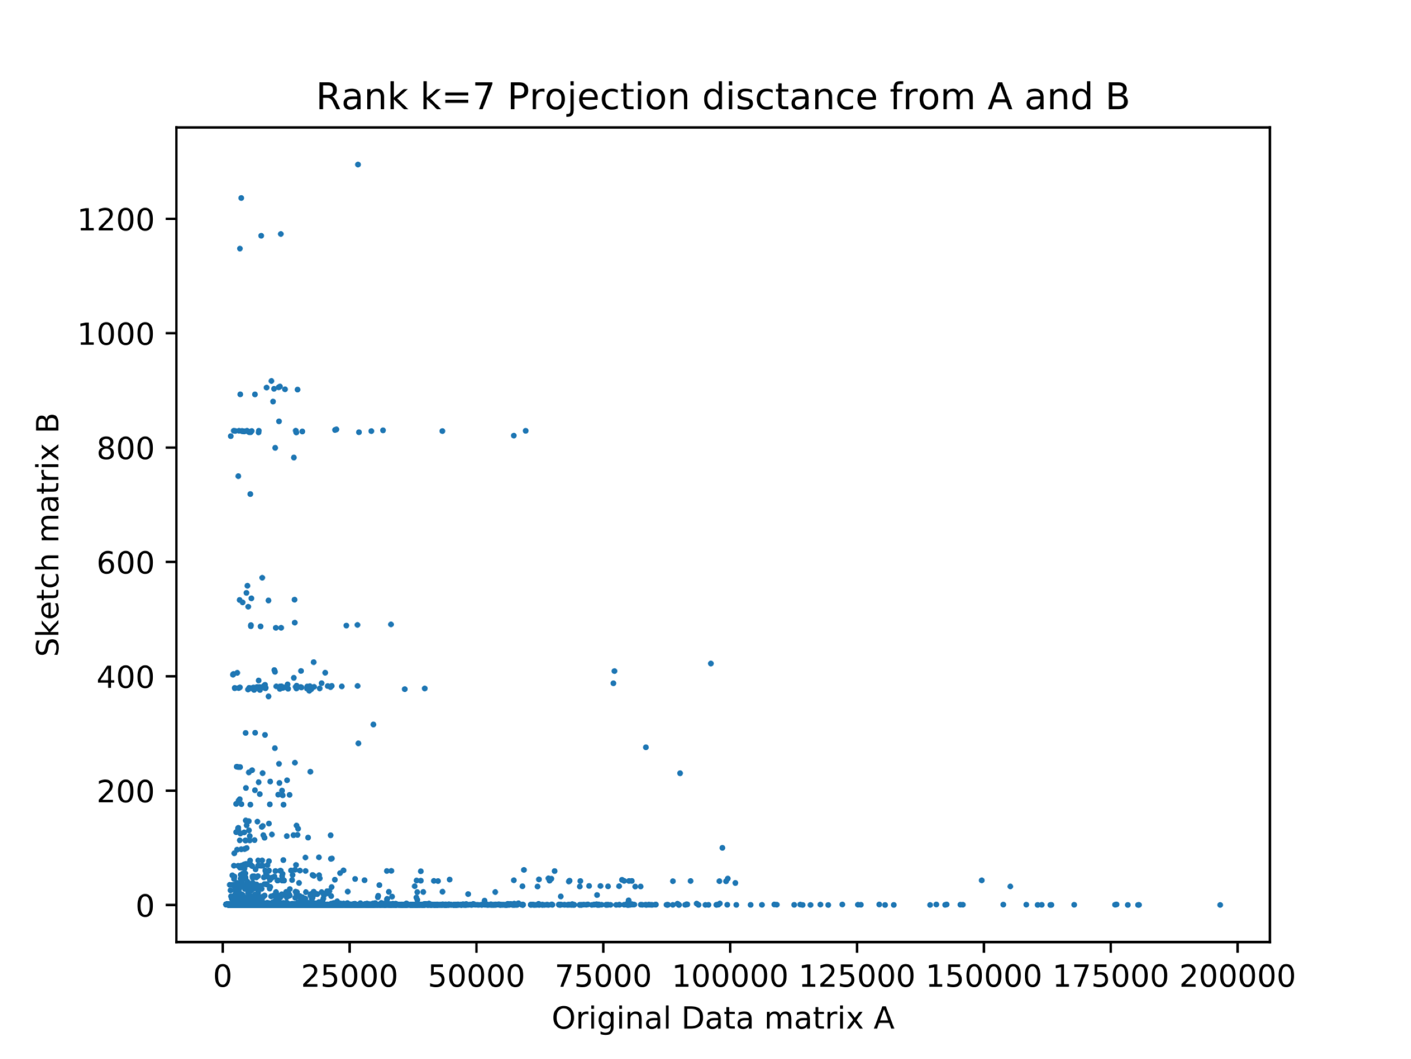
3.4. Results
Comparison of estimated AD scores ($L_{7}, T_{7}$) derived from A and sketch B given $ℓ$=100

Slide 20
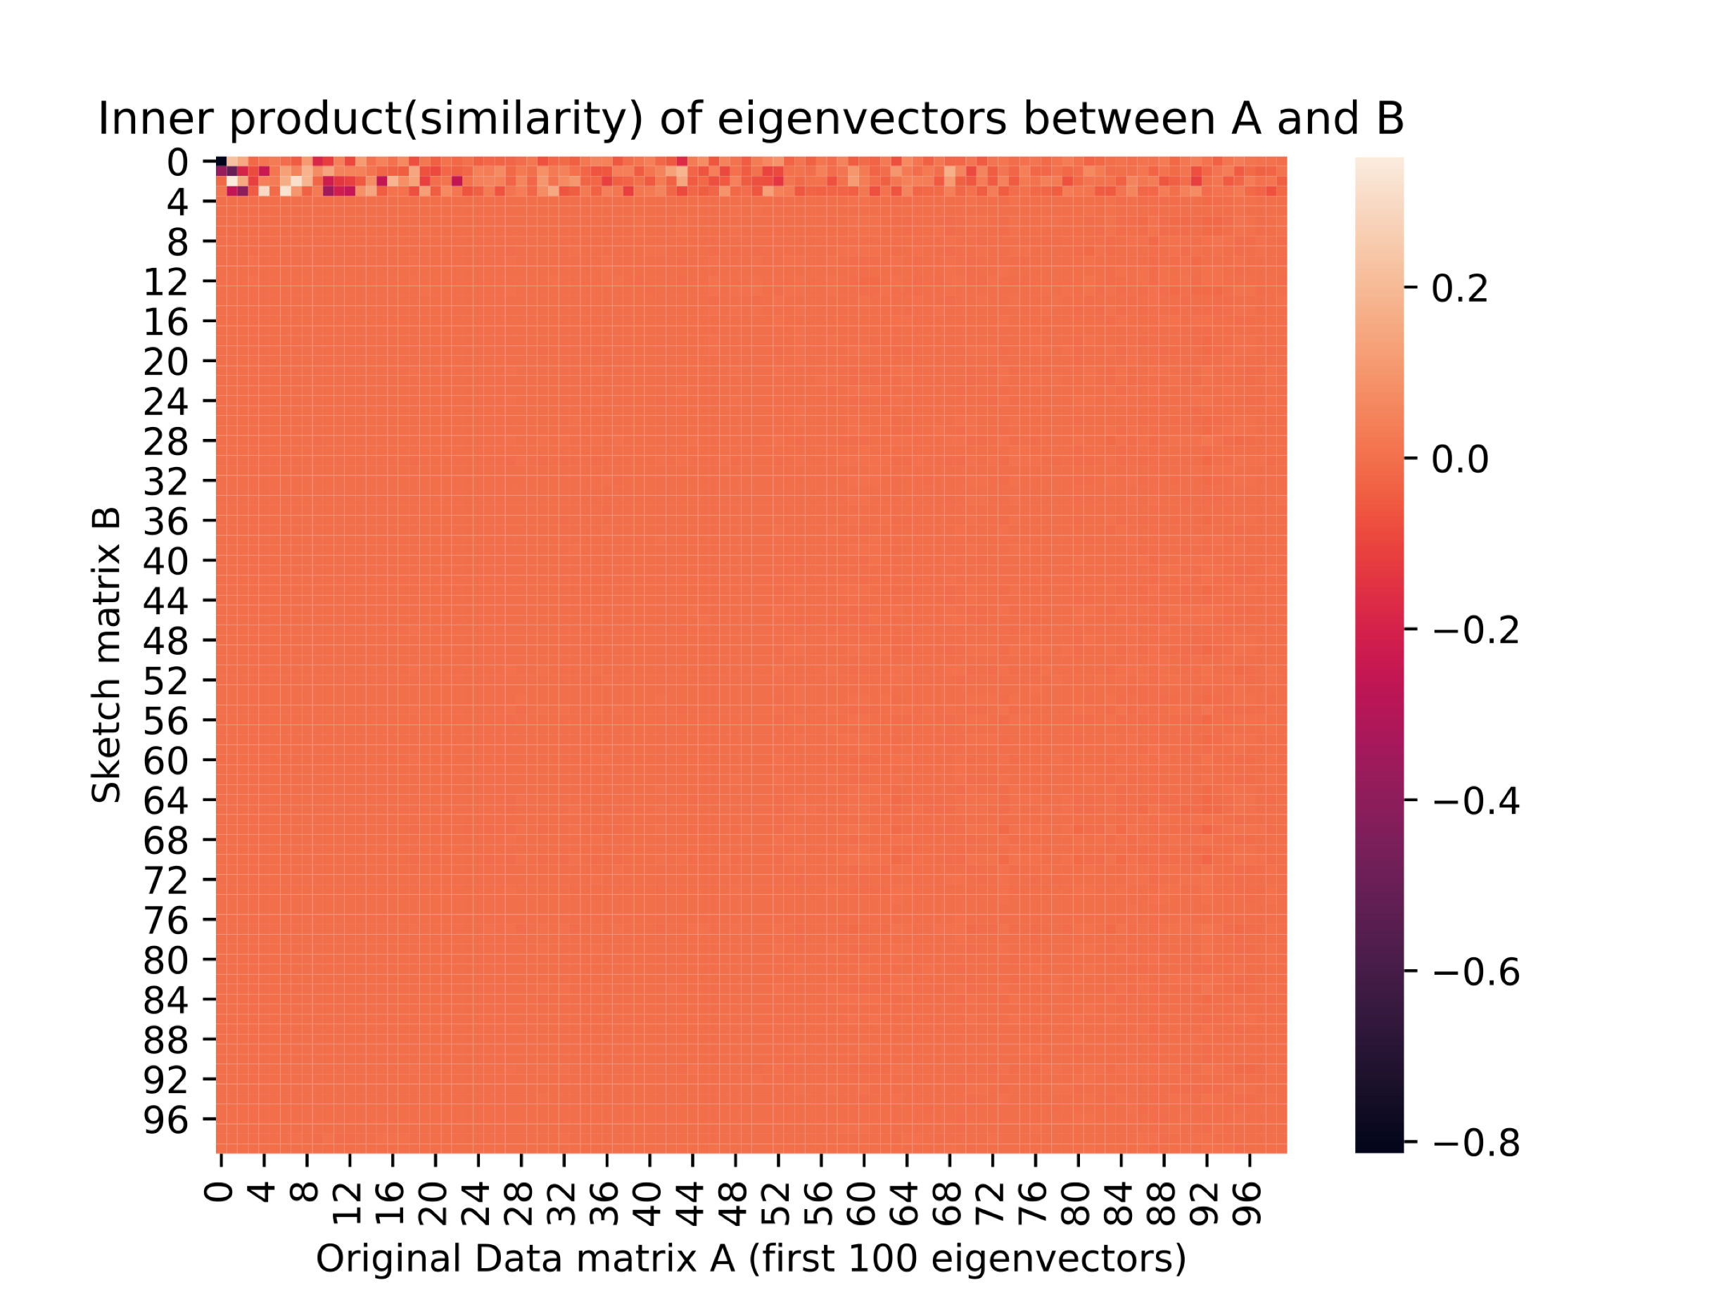
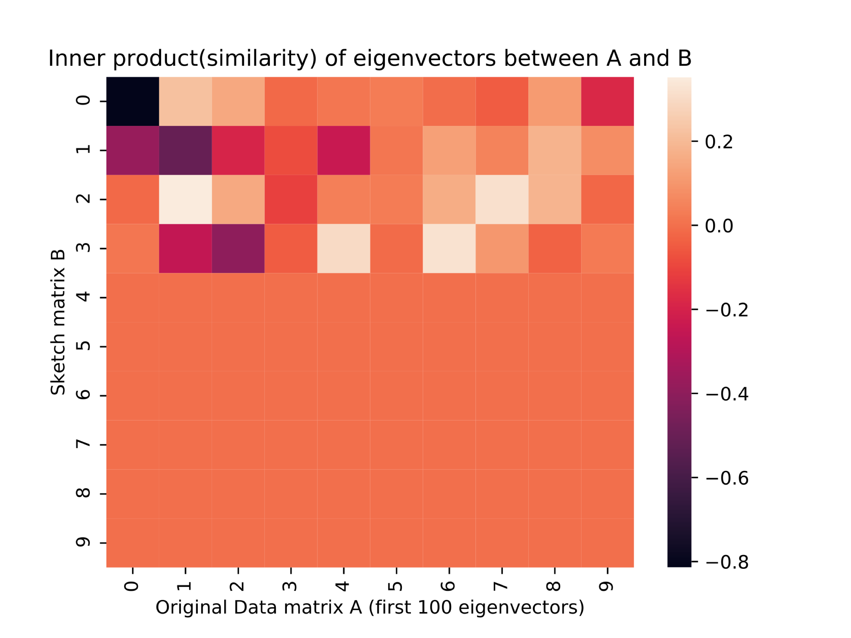
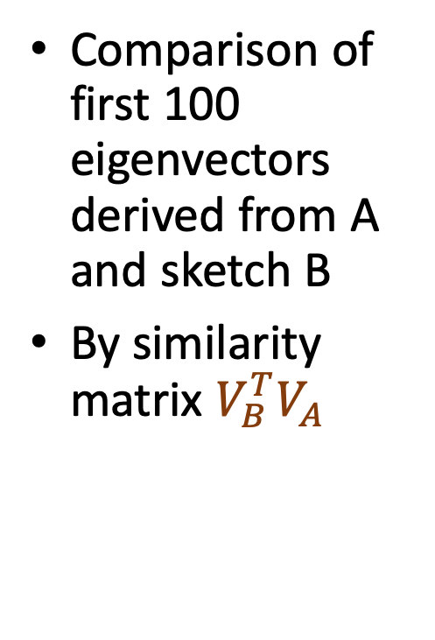
3.4. Results
Comparison of first 100 eigenvectors derived from A and sketch B
By similarity matrix $V_{B}^{T}V_{A}$

Slide 21
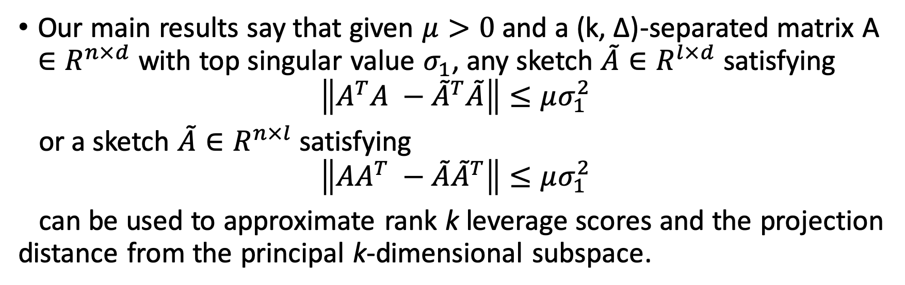
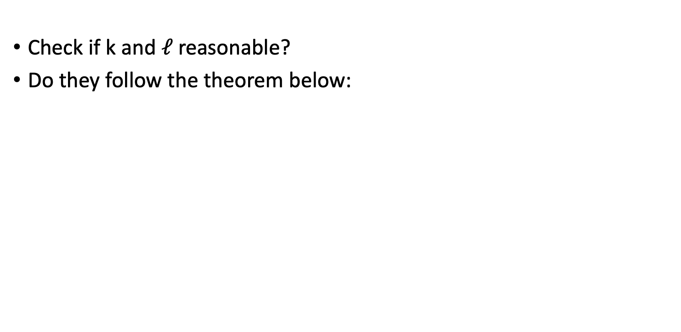
3.5. Conclusion
Check if k and $ℓ$ reasonable?
Do they follow the theorem below:

Slide 22
老師回饋
下週任務：
試著用osPCA分析Data(e.g., p53 mutants) 比較他們的ground truth (Sharan, V., Gopalan, P., & Wieder, U. (2018) ) 與osPCA結果差異
Paper至少一篇讀清楚
找paper的Github(Github上搜尋)
osPCA未來研究
osPCA error bound 證明（老師有想法但未證，未來可研究）
擴充至>= 2 eigenvectors →計算 row data projection到k個軸（e.g.k=2）的weights(e.g. w1, w2)=> AD scores for each eigenvector,算所有AD score加權整合，如果落到ball(正常範圍)外，則視為異常。
Notes:
algorithm 1 paper source:
fEfficient anomaly detection via matrix sketching. In Advances in Neural Information Processing Systems (pp. 8069-8080).

